Slide 1
This file contains the source images for the circular prompts used by the Grasp.exe program.
See GraspBMP.mak for instructions on how to convert this file into the .bmp files needed by the program.

Slide 2
Ready to start next trial.
Press a button to continue.

Slide 3
Trial block completed.
Click ‘Select’ to exit. Click and hold ‘Return’ to continue.

Slide 4
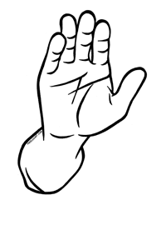
Lower Hand Lower Hand

Slide 5
Time to lower hand exceeded.
Press a button to continue.

Slide 6
Raise hand and aim at target.

Slide 7
Time to raise hand exceeded.
Press a button to continue.

Slide 8
Head t ilt not maintained.
Press a button to continue.

Slide 9
Time to t ilt head exceeded.
Press a button to continue.

Slide 10
Time to respond exceeded.
Press a button to continue.

Slide 11
Time limit exceeded.
Press a button to continue.

Slide 12
Time to rotate hand exceeded.
Press a button to continue.

Slide 13
Hand raised too soon.
Press a button to continue.

Slide 14
Hand should not be raised.
Press a button to continue.

Slide 15
Straighten head on shoulders.
When head is straight, press button.

Slide 16
VR activity completed.
Doff Virtual Reality Helmet and press Return.

Slide 17
VR appears to be working.
Press ‘Return’ to cont inue.

Slide 18
Trial voluntarily aborted.
Press a button to continue.

Slide 19
Previous trial invalidated.
Press a button to continue.

